Slide 1
MINI PROJECT :-
ALGORITHMS
SUDOKU
SOLVER

Slide 2
TEAM MEMBERS
ABHISHEK CHOUDHARY ( 20ME10003 )
RAHUL DAS ( 20ME30073 )
Abhyuday Agrawal ( 20MT10002 )

Slide 3
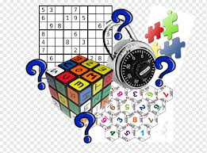
Sudoku Solver
By Backtracking Algorithm

Slide 4
Content
Introduction
Aim and Objective
Problem Statement
Brute Forces Approach
Back Tracking Approach
Proposed Model
Flow chart
Work Description
Member’s Contribution
Conclusion

Slide 5
Introduction
Sudoku is a puzzle that has enjoyed worldwide popularity since 2005. To solve a Sudoku puzzle, one needs to use a combination of logic and trial-and-error. More math is involved behind the scenes: combinatorics used in counting valid Sudoku grids, group theory used to describe ideas of when two grids are equivalent, and computational complexity with regards to solving Sudoku.
The game in its current form was invented by American Howard Garns in 1979 and published by Dell Magazines as "Numbers in Place." In 1984, Maki Kaji of Japan published it in the magazine of his puzzle company Nikoli. He gave the game its modern name of Sudoku, which means “Single Numbers”. The puzzle became popular in Japan and was discovered there by New Zealander Wayne Gould, who then wrote a computer program that would generate Sudoku. He was able to get some puzzles printed in the London newspaper The Times beginning in 2004. Soon after, Sudoku-fever swept England. The puzzle finally became popular in the U.S. in 2005. It has become a regular feature in many newspapers and magazines and is enjoyed by people all over the globe.

Slide 6
The standard version of Sudoku consists of a 9×9 square grid containing 81 cells. The grid is subdivided into nine 3×3 blocks. Some of the 81 cells are filled in with numbers from the set {1,2,3,4,5,6,7,8,9}. These filled-in cells are called givens. The goal is to fill in the whole grid using the nine digits with a rule.
Rule
1 - Each row must contain the numbers from 1 to 9, without repetitions.
2 - Each column must contain the numbers from 1 to 9, without repetitions.
3 - Each block must contains the numbers from 1 to 9, without repetitions.
Detailed explanation is shown in diagram in next slide.

Slide 7
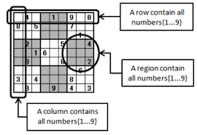

Slide 8
Aim and Objective
Our objective is to successfully implement a novel approach to resolve computationally in depth problems like Sudoku.
To resolve the classical Sudoku puzzle by using the Backtracking approach and comparing it with Brute forces approach.

Slide 9
Problem Statement
Our job is to place a number into every empty box so that each row across, each column down, and each small 9 blocks within the large square (there are 9 of these) will contain each number from 1 to 9. Remember that no number may appear more than once in any row across, any column down, or within any small 9 blocks. The numbers will be filled with the help of these pattern matching.

Slide 10
Brute Forces Approach
The brute forces approach is to generate all possible configurations of numbers from 1 to 9 to fill the empty cells. Try every configuration one by one until the correct configuration is found, i.e. for every unassigned position fill the position with a number from 1 to 9. After filling all the unassigned position check if the matrix is safe or not. If safe print else recurs for other cases.

Slide 11
Complexity Analysis:
Time complexity: O(9^N*N)
O(N^M), where N is the number of possibilities for each square (i.e., 9 in classic Sudoku) and M is the number of spaces that are blank. where T(N) is the running time of the solution for a problem size of N.
For worse case M=N*N
Solving this recurrence will yield, O(9^(N*N)).
Space Complexity: O(N*N) To store the output array a matrix is needed.

Slide 12
Back Tracking Approach
Backtracking is a technique to solve problems where multiple choices are there and we don't know the correct choice and hence we solve problem with trial and error i.e. trying each option until goal is achieved.
We basically check that the same number is not present in current row, current column and current 3X3 sub grid. After checking for safety, we assign the number, and recursively check whether this assignment leads to a solution or not. If the assignment doesn't lead to a solution, then we try next number for current empty cell. And if none of number (1 to 9) lead to solution, we return false.

Slide 13
Complexity Analysis:
Time complexity: O(9^N*N)
O(N^M), where N is the number of possibilities for each square (i.e., 9 in classic Sudoku) and M is the number of spaces that are blank. where T(N) is the running time of the solution for a problem size of N.
For worse case M=N*N
Solving this recurrence will yield, O(9^(N*N)).
Space Complexity: O(N*N) To store the output array a matrix is needed.

Slide 14
Proposed Model
To solve Sudoku, we will make Algorithm using back tracking approach.
The Sudoku solver code is explained below in following steps.
Step 1. Define a method called isPresentInCol(), this will take col and num, where col is column no. and num is a number in Sudoku.
Step 2. for each row r in the grid, do
if grid[r, col] = num, then return true
return false otherwise
Step 3. Define a method called isPresentInrow(), this will take row and num, where row is row no. and num is a number in Sudoku.
Step 4. for each column c in the grid, do
if grid[row, c] = num, then return true
return false otherwise
Step 5. Define a method called isPresentBox(), this will take boxStartRow, boxStartCol and num, where boxStartRow is a starting index of row of a small box(3*3 dim.) in which the num is present. Similarly boxStartCol…..

Slide 15
Step 6. for each row r in boxStartRow to next 3 rows, do
for each column c in boxStartCol to next 3 columns, do
if grid[r, c] = num, then return true
return false otherwise
Step 7. Define a method called findEmptyPlace(), this will take row and col
Step 8. for each row r in the, do
for each column c in the grid,
if grid[r, c] = 0, then return true
return false otherwise
Step 9. Define a method called isValidPlace(), this will take row, col, num
Step 10. if isPresentInRow(row, num) and isPresentInCol(col, num) and isPresntInBox(row – row mod 3, col – col mod 3, num) all are false,
then return true
Step 11. Define a method called solveSudoku(), this will take the grid
Step 12. if no place in the grid is empty, then return true

Slide 16
Step 13. for number 1 to 9, do
if isValidPlace(row, col, number), then
grid[row, col] = number
if solveSudoku = true, then return true
grid[row, col] = 0
return false
Step 14. Define a method called print Sudoku(), this will print the solved grid

Slide 17
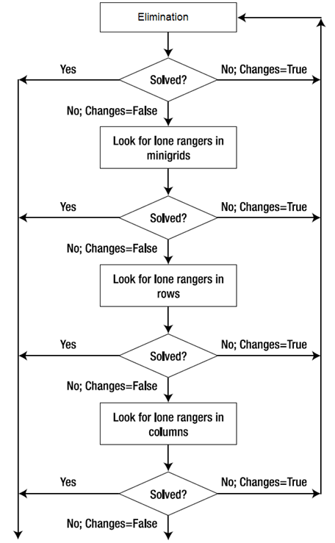
Flow Chart
Back Tracking Approach

Slide 18
Work Description
Weeks | Works
Week 1 | Concept, Idea
Week 2 | Algorithm and Flowchart
Week 3 | Logic and Logic build up
Week 4 | Create Algorithm
Week 5 | Updating Algorithm and Flowchart
Week 6 | Commenting, Completing code and Testing…..
Week 7 | Presentation

Slide 19
Member’s Contribution
Abhishek Choudhary - Algorithm implementation and Slides making
Rahul Das - Program concept, Idea, Flowchart and Slides making
Abhyuday Agrawal - Algorithm implementation and Slides making

Slide 20
Conclusion
The time complexity of our both approaches remains the same but there will be some early pruning so the time taken will be much less than the brute forces algorithm but the upper bound time complexity remains the same.
The algorithm seems to be a useful method to solve any Sudoku puzzles and it can guarantee to find at least one solution. However, this algorithm is not efficient because the level of difficulties is irrelevant to the algorithm. In other words, the algorithm does not adopt intelligent strategies to solve the puzzles. This algorithm checks all possible solutions to the puzzle until a valid solution is found which is a time consuming procedure resulting an inefficient solver. As it has already stated the main advantage of using the algorithm is the ability to solve any puzzles and a solution is certainly guaranteed.

Slide 21
THANK YOU

